Slide 1
Bank Marketing status Prediction
By
R.Subhasri

Slide 2
Agenda
Problem Statement
Project Flow
Data collection
Preprocessing
First Data-Frame
Class Imbalance
Outliers
Second Data-Frame
Feature Engineering
Third Data-Frame

Slide 3
Problem Statement
The data set is based off the direct marketing campaigns. It was based on phone calls.
More than one contact to a client was required, in order to know if the product (bank term deposit) was subscribed by a client or not.
The classification goal is to predict if a client will subscribe to the bank term deposit (yes/no).

Slide 4
Flow Chart
Data collection
Data Preprocessing
Data Frame 1
Class Imbalance
EDA
Dara Frame 2
Feature Selection
Data Frame 3

Slide 5
Data Collection
The dataset contains 11302 rows and 15 columns
It has 6 columns consist of numerical and 9 categorical data
Target Column(client subscribed) is categorical so,I perform classification Machine Learning Algorithm.

Slide 6
Preprocessing
Missing value treatment
Data type conversion
Duplicate checking

Slide 7
DATA FRAME 1
S.No | MODEL_NAME | Accuracy | FPR | TPR | F1-SCORE
0 | log | 88.721805 | 0.837209 | 0.980529 | 0.939039
1 | dt | 85.891199 | 0.581395 | 0.944644 | 0.934584
2 | rf | 89.473684 | 0.748062 | 0.971543 | 0.939010
3 | svc | 88.589120 | 0.833333 | 0.980030 | 0.939010
4 | knn | 88.721805 | 0.992248 | 0.999001 | 0.939437
5 | adaboost | 85.714286 | 0.577519 | 0.916126 | 0.920641
6 | xgboost | 89.208315 | 0.643411 | 0.961058 | 0.940401

Slide 8
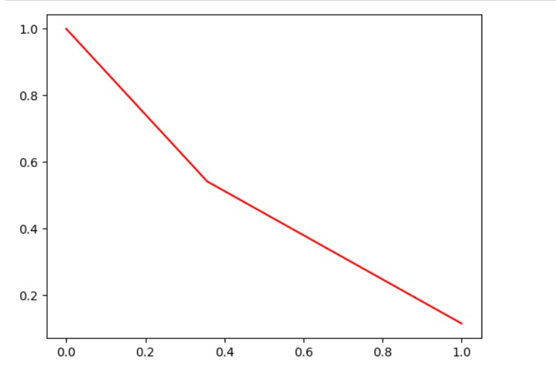
Conclusion for Data Frame 1
In data frame 1 have XGboost achieves the highest accuracy of 89.20 with a false positive rate (FPR) of 0.64 and true positive rate (TPR) of 0.96
Result of PRC curve

Slide 9
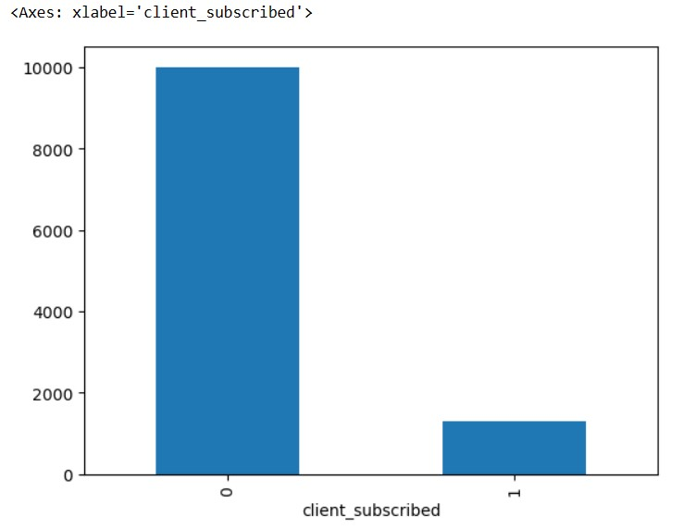
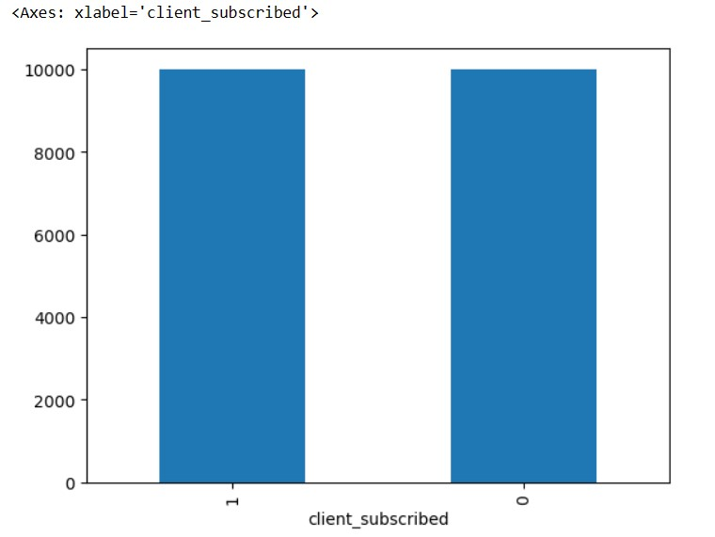
CLASS IMBALANCE
I perform oversampling technique these are before and after the
class imbalance of Target Variable.
Before
After

Slide 10
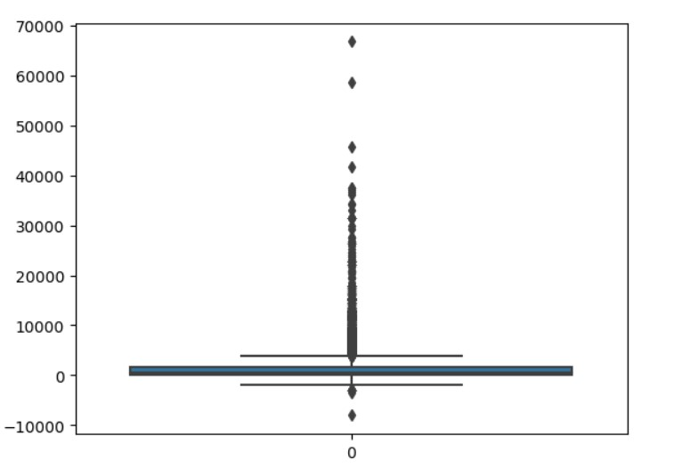
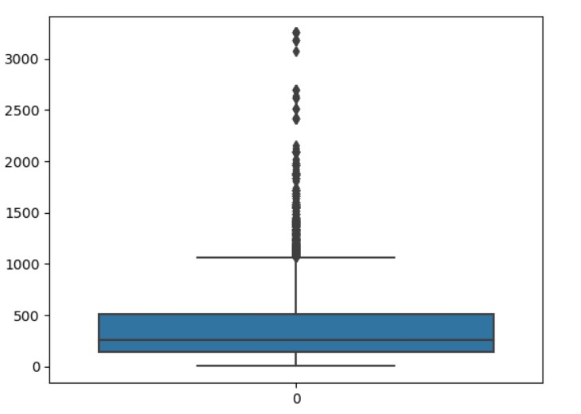
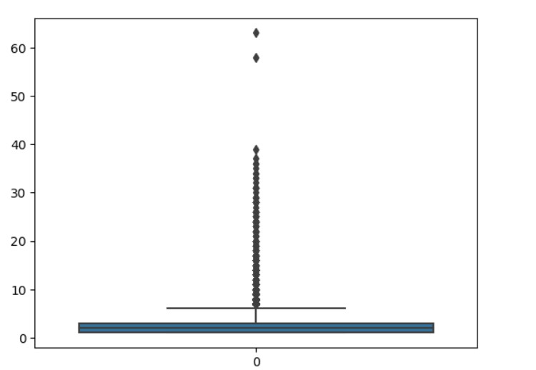
Outlier Treatment
OUTLIER
Box Plot For Outlier in data
Campaign
Balance
Duration

Slide 11
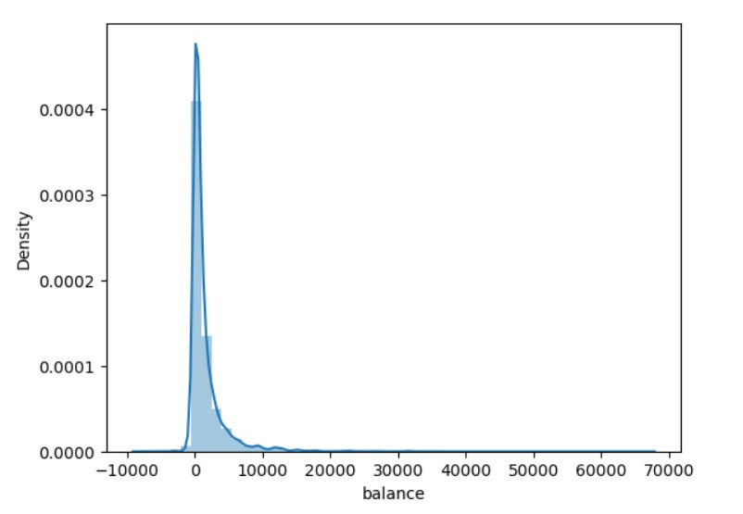
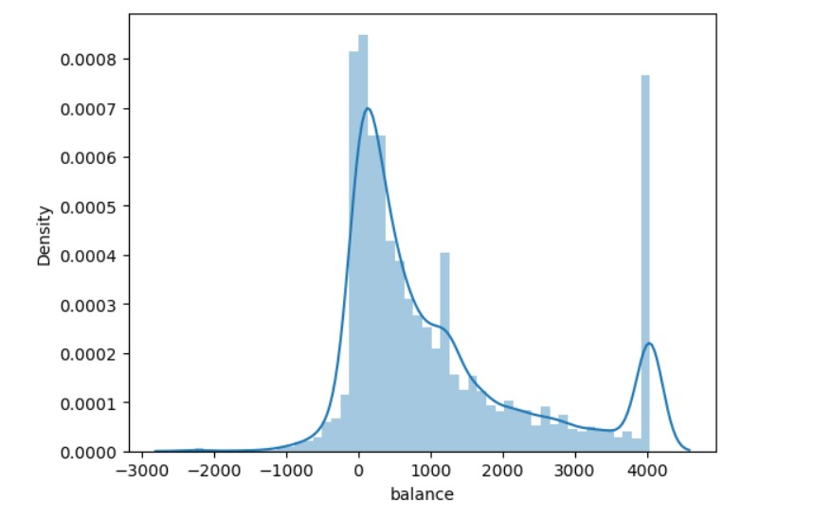
SKEWNESS
Balance
Before
After

Slide 12
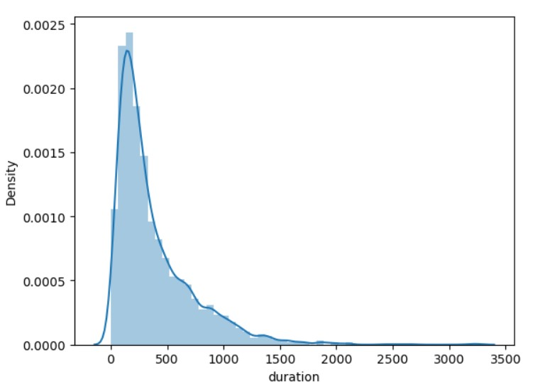
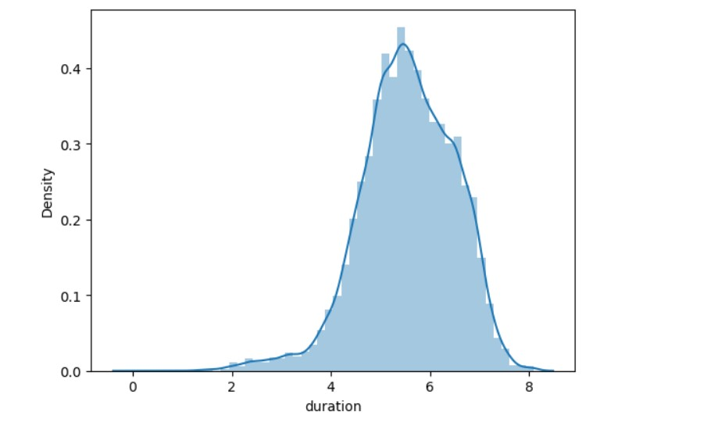
DURATION
Before
After

Slide 13
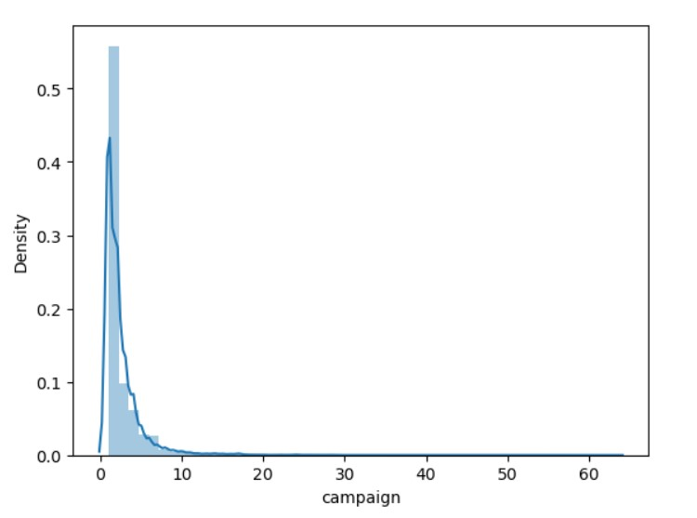
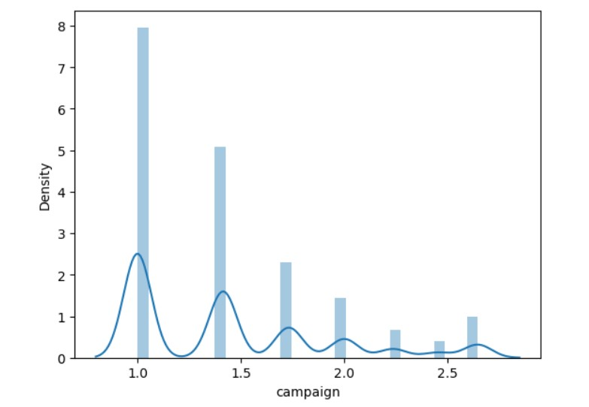
Campaign
Before
After

Slide 14
DATA FRAME 2
S.No | MODEL_NAME | Accuracy | FPR | TPR | F1-SCORE
0 | log | 73.256686 | 0.229075 | 0.654750 | 0.691478
1 | dt | 95.701075 | 0.000000 | 0.918795 | 0.957679
2 | rf | 97.250687 | 0.000979 | 0.944842 | 0.971129
3 | svc | 56.935766 | 0.431718 | 0.589888 | 0.578223
4 | knn | 72.381905 | 0.177680 | 0.652905 | 0.710483
5 | adaboost | 95.576106 | 0.004895 | 0.922880 | 0.957351
6 | xgboost | 95.426143 | 0.001958 | 0.904494 | 0.948835

Slide 15
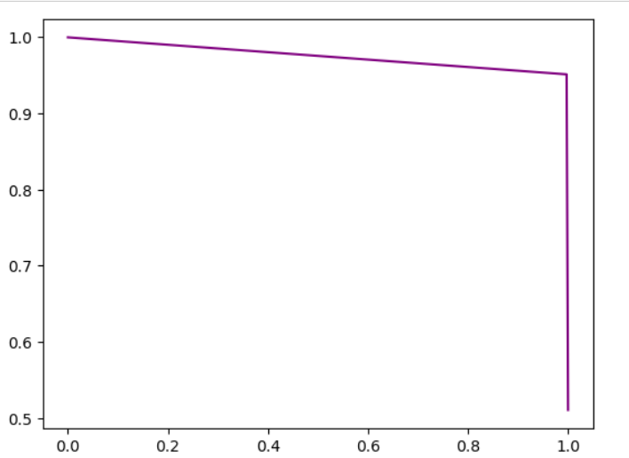
Conclusion for Data Frame 2
In data frame 2 have Random Forest achieves the highest accuracy of 97.25 with a false positive rate (FPR) of 0.000979 and true positive rate (TPR) of 0.94.
Result of PRC curve

Slide 16
Feature Engineering
Perform Recursive Feature Elimination
Dataset having 13 column in that only 6 column selected as a importance feature which are significant.

Slide 17
DATA FRAME 3
S.No | MODEL_NAME | Accuracy | FPR | TPR | F1-SCORE
0 | log | 73.731567 | 0.270680 | 0.720848 | 0.633122
1 | dt | 95.201200 | 0.000000 | 0.917773 | 0.957124
2 | rf | 96.675831 | 0.083445 | 0.934116 | 0.920715
3 | nb | 56.710822 | 0.434486 | 0.559441 | 0.558047
4 | svc | 76.230942 | 0.210475 | 0.745659 | 0.758836
5 | knn | 78.205449 | 0.187469 | 0.752298 | 0.772417
6 | adaboost | 95.426143 | 0.000000 | 0.916968 | 0.956685

Slide 18
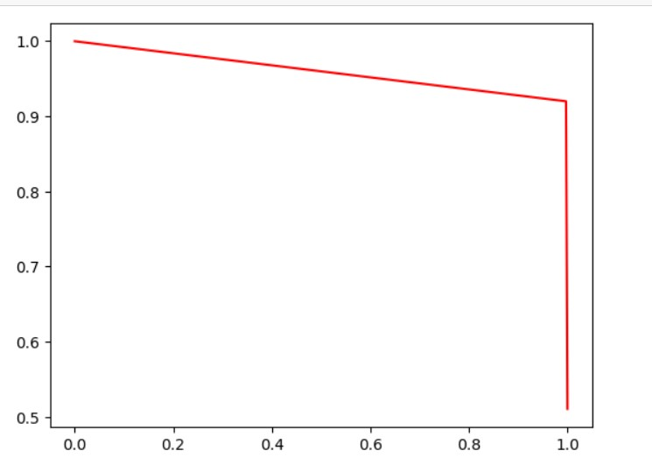
Conclusion for Data Frame 3
Random forest achieves the highest accuracy of 96.65 with a false positive rate (FPR) of 0.083 and true positive rate (TPR) of 0.93
Result of PRC curve

Slide 19
Demerits
Data Quality Issues: Inaccurate or incomplete data can lead to biased predictions and undermine the effectiveness of the marketing strategy.
Overfitting: Complex models may overfit the training data, resulting in poor generalization to unseen data.
Model Maintenance: Regular updates and monitoring are required to ensure the model's relevance and performance over time, adding to maintenance costs and complexity.

Slide 20
THANK YOU..

